Slide 1
Introduction to Computing
CMPE150
Chapter 6
PS
Week 10

Slide 2
Lists and Tuples
Lists and tuples can contain items of different types and type of any item can be retrieved by using the type() function.
Types in question:
Integers
Bools
Strings
Floats
Lists
Tuples
Sets
Dictionaries
Notes:
Lists and tuples can contain items of mixed types and the type of any item can be retrieved by using the type()function:

Slide 3
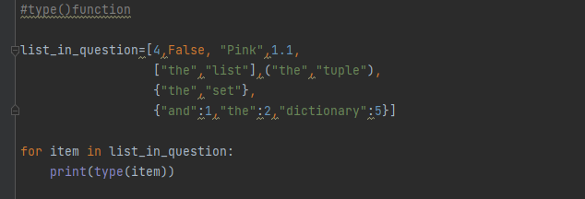
CODE

Slide 4
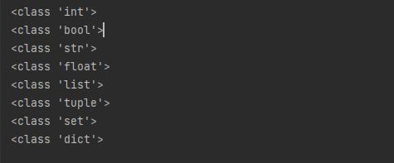
CODE
OUTPUT

Slide 5
Lists and Tuples
* operator can be used for assigning the items of a tuple that are not assigned yet to a list together.
Notes:
Lists and tuples can contain items of mixed types and the type of any item can be retrieved by using the type()function:

Slide 6
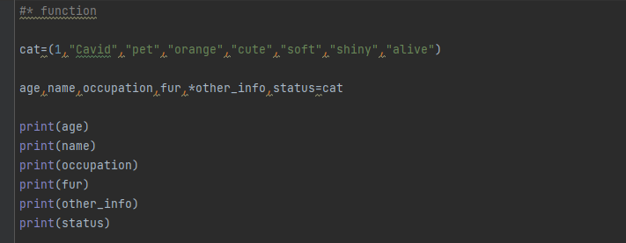
CODE

Slide 7
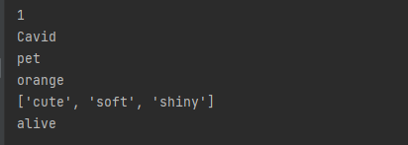
CODE
OUTPUT

Slide 8
Lists and Tuples
Slicing can be done on lists and tuples as it was done on strings.
Negative indexes can be used while slicing.
If a len(list)=10, list[-3] and list[7] are the same item on that list.
|-3|+|7|=10
Notes:
Lists and tuples can contain items of mixed types and the type of any item can be retrieved by using the type()function:

Slide 9
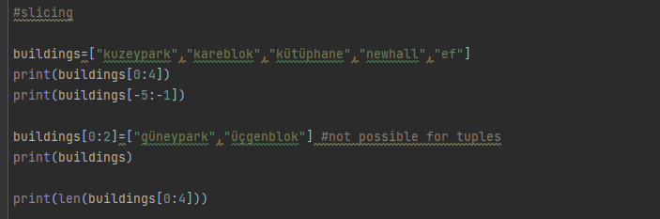
CODE

Slide 10
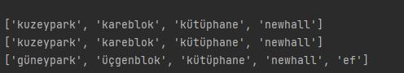
CODE
OUTPUT

Slide 11
METHODS
insert() function can be used for adding items to lists and tuples at a desired index.
list.insert(x,y) line will add y item to the list at the index x.
append() function can be used for adding items to the end of lists and tuples.
tuple.append(x) line will add x item to the tuple as the last item.
Notes:
Lists and tuples can contain items of mixed types and the type of any item can be retrieved by using the type()function:

Slide 12
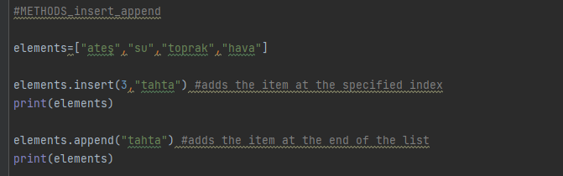
CODE

Slide 13

CODE
OUTPUT

Slide 14
METHODS
extend() function can be used for adding items in a set/list/tuple to the end of a list.
list1.insert(set or list2 or tuple) line will add their items at the end of list1.
Notes:
Lists and tuples can contain items of mixed types and the type of any item can be retrieved by using the type()function:

Slide 15
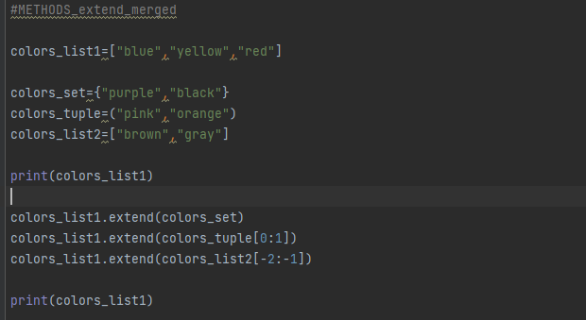
CODE

Slide 16

CODE
OUTPUT

Slide 17
METHODS
extend() function can be used for adding items in a set/list/tuple to the end of a list.
list1.insert(set or list2 or tuple) line will add their items at the end of list1.
+ operator can be used for merging lists and tuples together.
mergedlist= list1+list2, mergedlist will have every item from list1 and list2.
Notes:
Lists and tuples can contain items of mixed types and the type of any item can be retrieved by using the type()function:

Slide 18
METHODS
remove() function can be used for removing specific items from lists and tuples.
If the item is in the list/tuple more than once, it will only remove the first one.
pop() function can be used for removing a item by their index on the list/tuple.
If no index is specified, it will remove the last item on the list/tuple.
Notes:
Lists and tuples can contain items of mixed types and the type of any item can be retrieved by using the type()function:

Slide 19
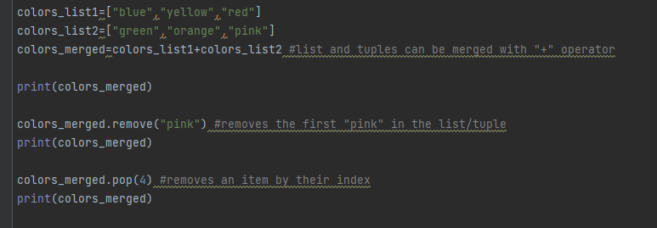
CODE

Slide 20
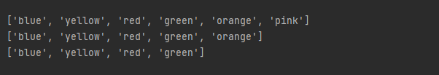
CODE
OUTPUT

Slide 21
METHODS
del keyword can be used for removing items in a set/list/tuple, making them inaccessible.
It can be used with index.
It can also be used for deleting the whole list/set/tuple if wanted.
clear() function can be used for clearing every item from list/tuple.
Notes:
Lists and tuples can contain items of mixed types and the type of any item can be retrieved by using the type()function:

Slide 22
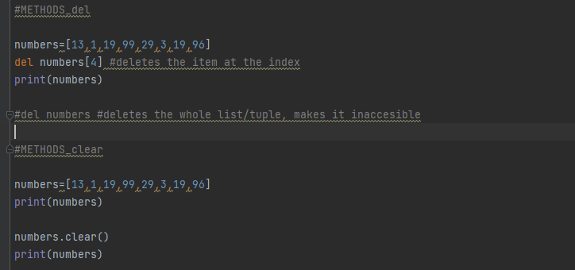
CODE

Slide 23
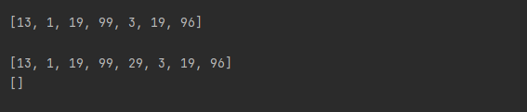
CODE
OUTPUT

Slide 24
METHODS
sort() function can be used for sorting the lists/tuples in a ascending/alphabetical order.
It can be reversed by adding reverse=True argument in the sort() function.
It works for both strings and integer/floats, but it does not work when the list/tuple has both at the same time.
reverse() function can be used for simply reversing the order of items in a list/tuple.
Notes:
Lists and tuples can contain items of mixed types and the type of any item can be retrieved by using the type()function:

Slide 25
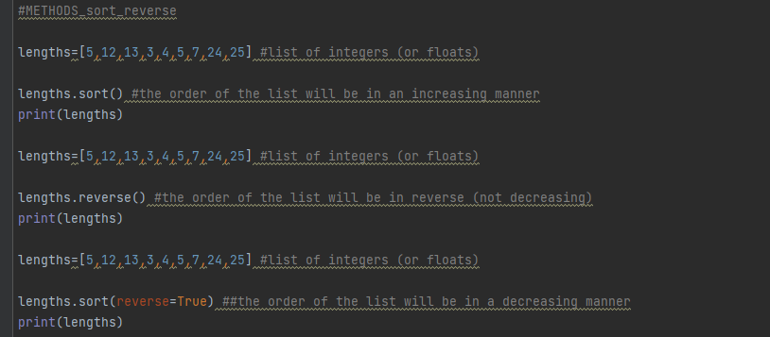
CODE

Slide 26

CODE
OUTPUT

Slide 27
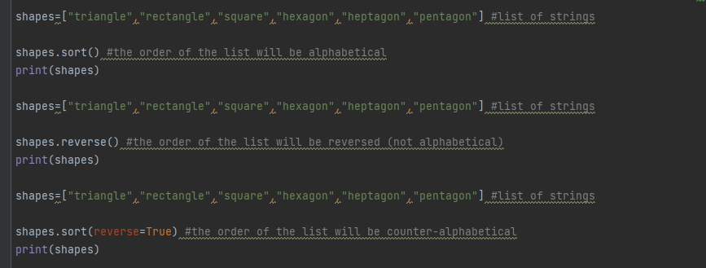
CODE

Slide 28

CODE
OUTPUT

Slide 29
OPERATIONS
copy() function can be used for creating a copy of the original list.
Any modification done on the copy or the original will not affect the other.
Notes:
Lists and tuples can contain items of mixed types and the type of any item can be retrieved by using the type()function:

Slide 30
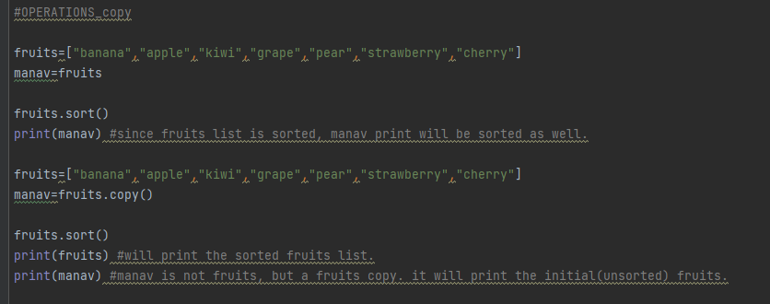
CODE

Slide 31

CODE
OUTPUT

Slide 32
OPERATIONS
copy() function can be used for creating a copy of the original list.
Any modification done on the copy or the original will not affect the other.
list() constructor method can be used for creating new lists from sets, tuples and other lists.
If the argument is a dictionary, the values will be ignored, and the new list will consist of the key set of the dictionary.
Notes:
Lists and tuples can contain items of mixed types and the type of any item can be retrieved by using the type()function:

Slide 33
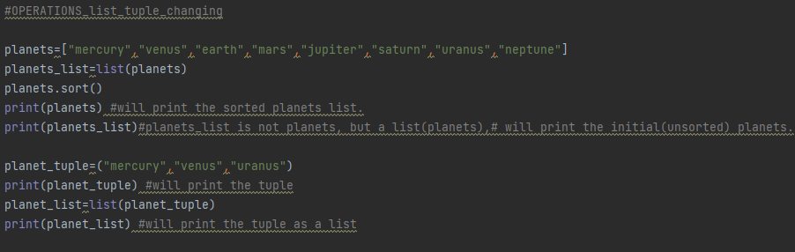
CODE

Slide 34
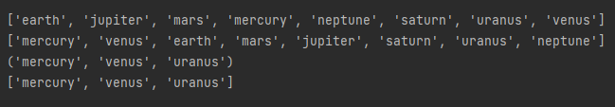
CODE
OUTPUT

Slide 35
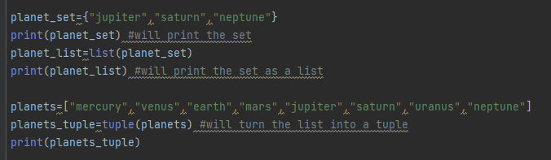
CODE

Slide 36

CODE
OUTPUT

Slide 37
OPERATIONS
* operator can be used for replicating the items on a list/tuple.
Replicated items will be added at the end of initial list/tuple.
count() method can be used for finding out how many times a specified item was repeated in a list/tuple.
index() method can be used for finding the index of a specified item in a list/tuple.
Notes:
Lists and tuples can contain items of mixed types and the type of any item can be retrieved by using the type()function:

Slide 38
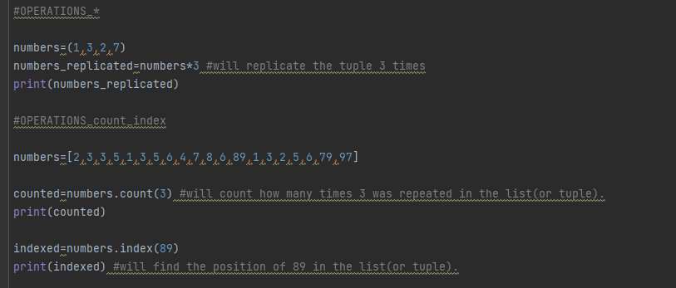
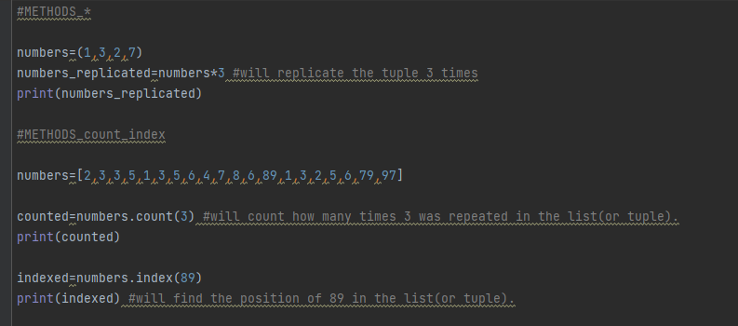
CODE

Slide 39

CODE
OUTPUT

Slide 40


